Slide 1

Using Machine Learning to Predict Heart Disease
Group 2
Yonatan Gorin
Desiree Joseph
BethAnn Wilde
June 12, 2023

Slide 2

Heart disease is the leading cause of death for men, women, and people of most racial and ethnic groups in the United States. One person dies every 33 seconds in the United States from cardiovascular disease. About 695,000 people in the United States died from heart disease in 2021—that’s 1 in every 5 deaths. Heart disease cost the United States about $240 billion each year from 2018 to 2019. This includes the cost of health care services, medicines, and lost productivity due to death. Heart Disease Facts | cdc.gov
Why Heart Disease

Slide 3
The Process of using Machine Learning to Predict Heart Disease
Found dataset related to heart disease
Conducted exploratory data analysis to try to understand dataset, different factors and relationships
Created machine learning models to predict heart disease
Looked at the results and made recommendations

Slide 4
The Dataset
Found on Kaggle.com https://www.kaggle.com/datasets/rishidamarla/heart-disease-prediction
Citation Janosi,Andras, Steinbrunn,William, Pfisterer,Matthias, and Detrano,Robert. (1988). Heart Disease. UCI Machine Learning Repository. https://doi.org/10.24432/C52P4X
Donated June 1988. Names and SSNs removed later.
Data from Cleveland – 14 attributes

Slide 5
The Dataset Attributes
Age in years
Sex (1 = male, 0 = female)
Chest pain type (1 = typical angina, 2 = atypical angina, 3 = non-anginal pain, 4 = asymptomatic)
Resting blood pressure (in mm Hg on admission to the hospital)
Serum cholesterol in mg/dl
Fasting blood sugar > 120 mg/dl (1 = true, 0 = false)
Resting electrocardiographic results (0 = normal, 1 = ST-T wave abnormality, 2 = probable or definite left ventricular hypertrophy)
Maximum heart rate achieved
Exercise induced angina (1 = yes, 0 = no)
ST depression induced by exercise relative to rest
Slope of the peak exercise ST segment (1 = upsloping, 2 = flat, 3 = downsloping)
Number of major vessels colored by fluoroscopy (0 to 3)
Thallium heart scan (0 = normal, 1 = fixed defect, 2 = reversable defect)
Heart disease (presence/absence)

Slide 6
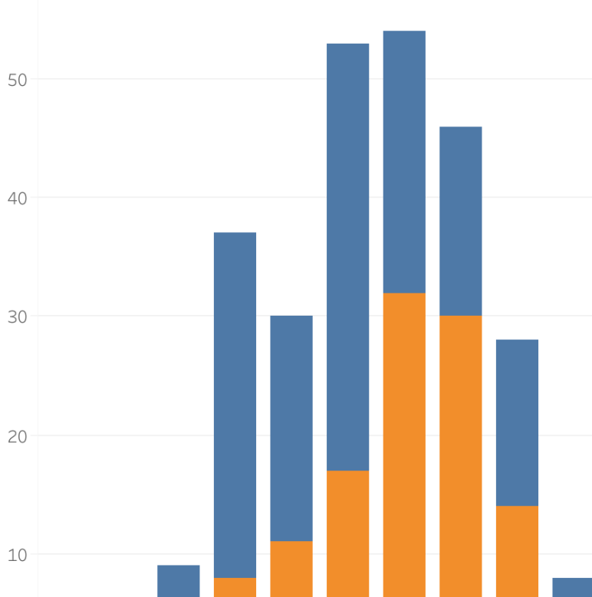
A Look at the Data (Exploratory Data Analysis)
The Story Starts Here

Slide 7

Multiple models were created to determine which are most effective in predicting heart disease. Supervised Learning Models: 1. Logistic Regression 2. Decision Tree 3. Random Forest 4. Support Vector Classifier (SVC) Neural Networks: 5. Sequential 6. Keras Tuner
Modeling Approach

Slide 8

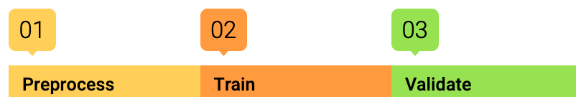
1. Preprocess data: - Changed strings to numbers where needed - Split into training and testing subsets - Normalized data 2. Train model with training subset 3. Validate model with testing subset
Modeling Steps

Slide 9
Accuracy indicates how often the model is correct. However, accuracy can be very susceptible to imbalanced classes. We must also measure for precision and recall to help eliminate false positives and false negatives. High precision relates to a low false positive rate. High recall relates to a low false negative rate. The F1 score is calculated from both the precision and recall of the test.
Measures of Success

Slide 10
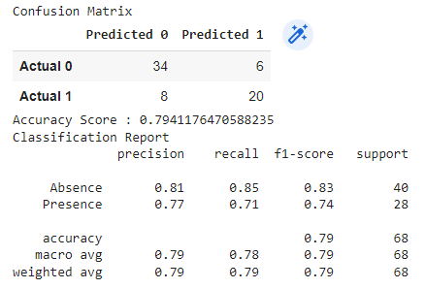
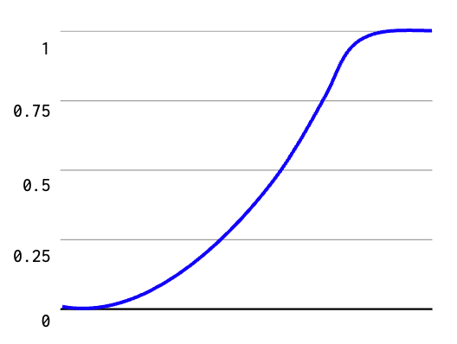
Logistic regression is a statistical method for predicting binary outcomes from data.
1. Logistic Regression

Slide 11
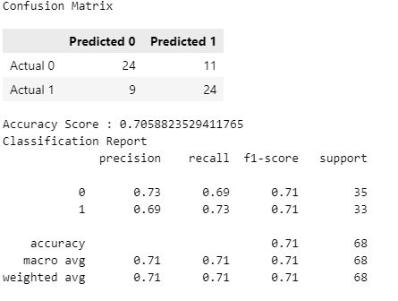
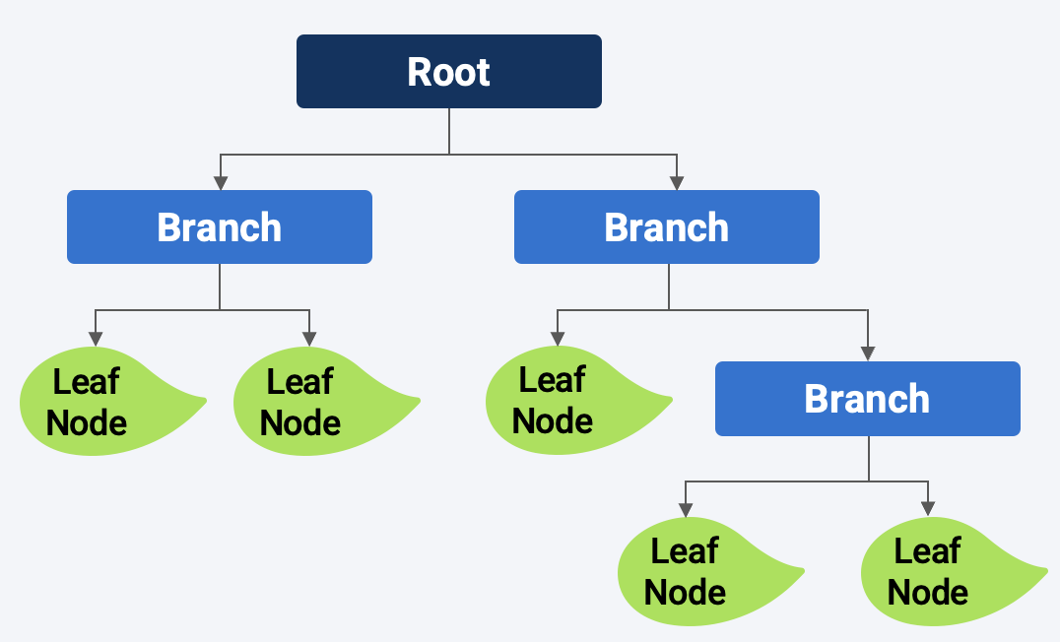
Decision trees encode a series of True/False questions that can be represented with a series of if/else statements.
2. Decision Tree
Notes:
Appears to be a weak learner.
Unlike logistic regression and support vector machines, decision trees are easy to audit, which is important for business applications.
A decision tree is a non-parametric supervised learning algorithm, which is utilized for both classification and regression tasks. It has a hierarchical, tree structure, which consists of a root node, branches, internal nodes and leaf nodes.

Slide 12
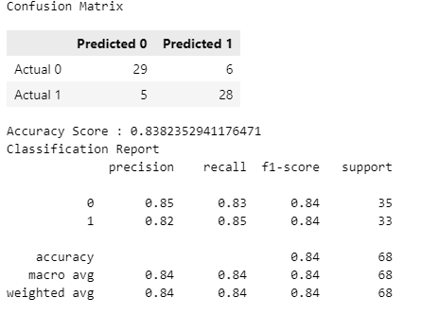
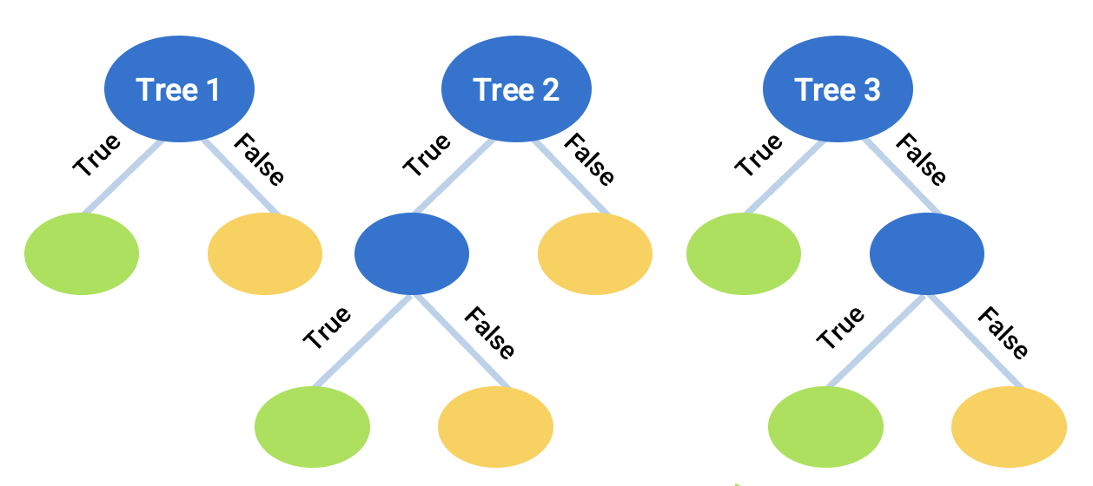
Instead of having a single, complex tree, a random forest algorithm will sample the data and build several smaller, simpler decision trees.
3. Random Forest

Slide 13
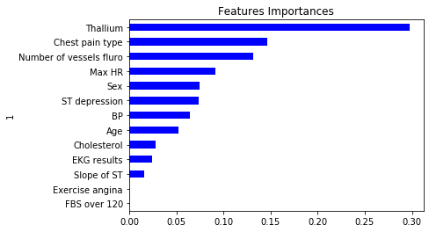
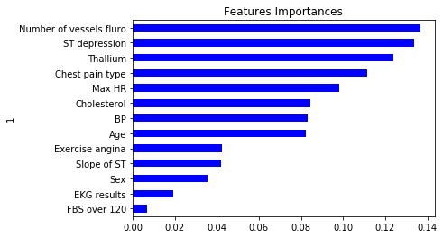
Visualizing Features by Importance
Decision Tree
Random Forest

Slide 14
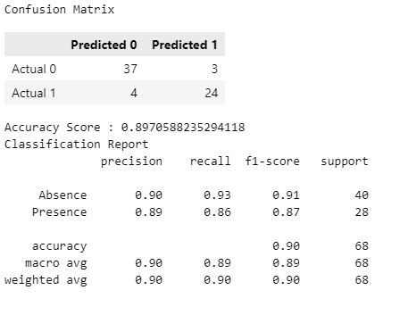
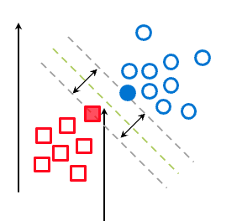
SVC maps data points to a high-dimensional space and then finds the optimal hyperplane that divides the data into two classes.
4. Support Vector Classifier

Slide 15
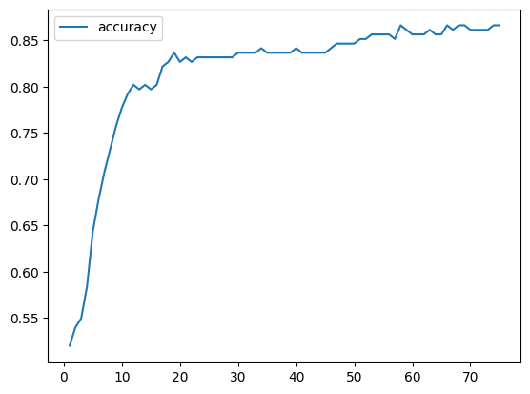
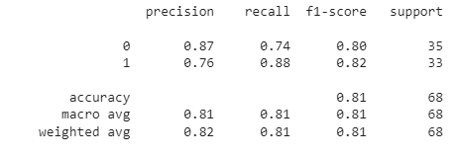
5. Sequential
A Sequential model is for plain stack of layers where each layer has exactly one input feature and one output target.

Slide 16
Sequential
A Sequential model is for plain stack of layers where each layer has exactly one input feature and one output target.

Slide 17
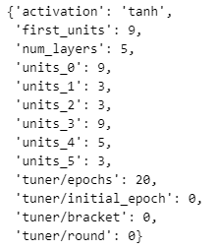
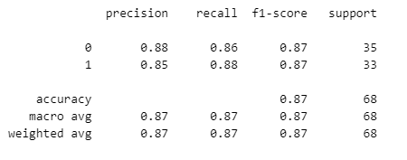
6. Keras Tuner
Keras Tuner is a library that helps pick the optimal set of hyperparameters.

Slide 18
Keras Tuner
Keras Tuner is a library that helps pick the optimal set of hyperparameters.

Slide 19
Summary of Results
Approach | F1 Score Presence (1) | F1 Score Absence (0) | Accuracy Overall
Logistic Regression | 0.74 | 0.83 | 0.79
Decision Tree | 0.71 | 0.71 | 0.71
Random Forest | 0.84 | 0.84 | 0.84
Support Vector | 0.87 | 0.91 | 0.90
Sequential | 0.82 | 0.80 | 0.81
Keras Tuner | 0.87 | 0.87 | 0.87

Slide 20
Model recommendation
Support Vector Classifier results in the highest weighted F1 scores and the greatest Accuracy of all the models tested and is our Recommendation
F1 scores and Accuracy:
Support Vector Classifier (SVC) : 0.90
Keras Tuner - .87
Random Forest - .84
Sequential - .81
Logistic Regression - .79
Decision Tree - .71

Slide 21
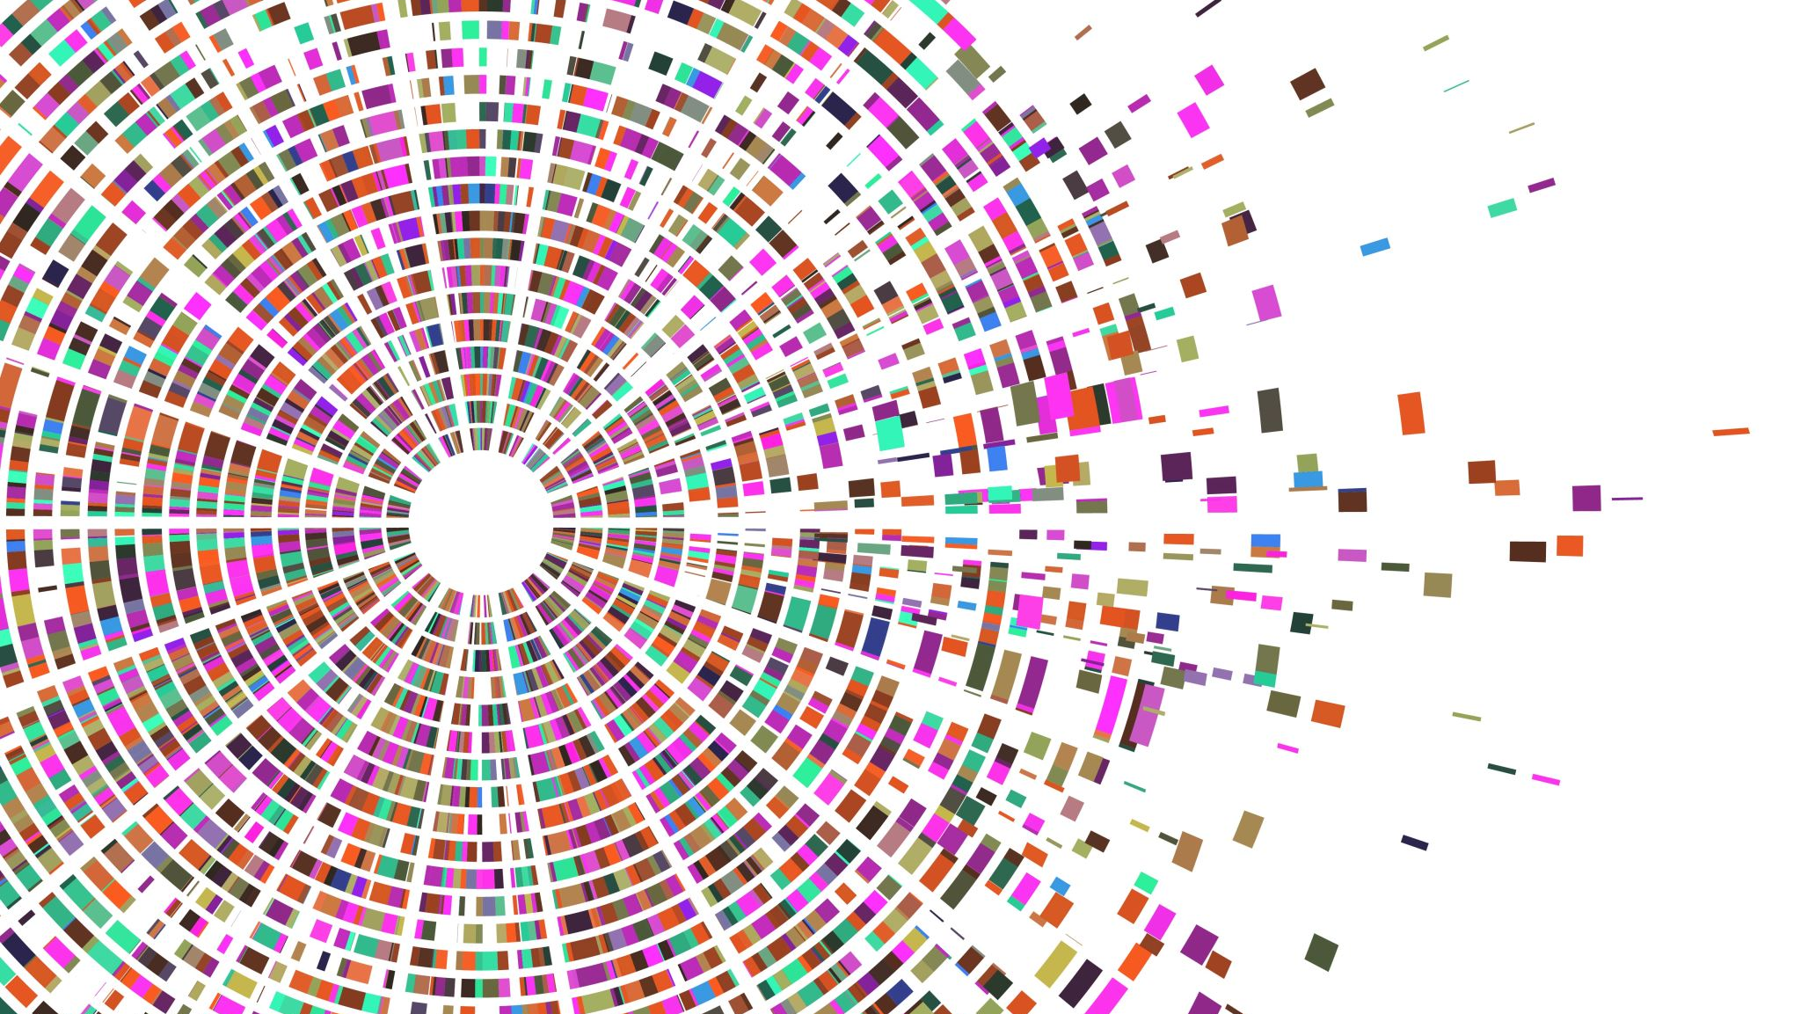
Thank You!
Q & A

